Slide 1
Unit 2

Slide 2
Research methodology
Research methodology refers to the methods and techniques used to portray the research effectively.
It concerns the systematic design of a study to guarantee results that meet the aims and objectives of the study.
The researcher is primarily responsible for presenting the idea and explaining different research methodology types.

Slide 3
Researchers employ various types of research methods to ensure that the data gathered is valuable and reliable.
Researchers categorize research methodology types according to different criteria. They are a general category, the nature of the study, the purpose of the study, the research design, and the data types.
Surveys and case studies are two of the most frequent data collection tools in research.
Employing research methods has many merits, including assisting the researcher in developing the study field and conducting the research more efficiently. Both contribute to the researcher’s knowledge of the subject matter.

Slide 4
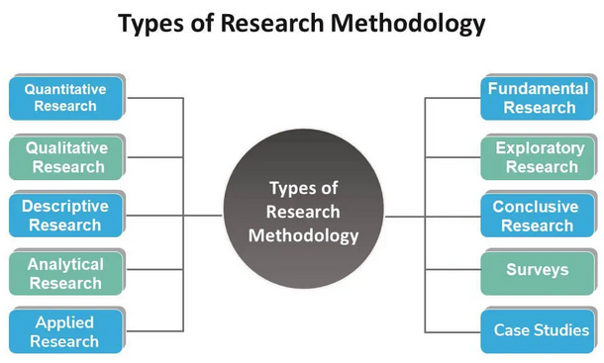

Slide 5
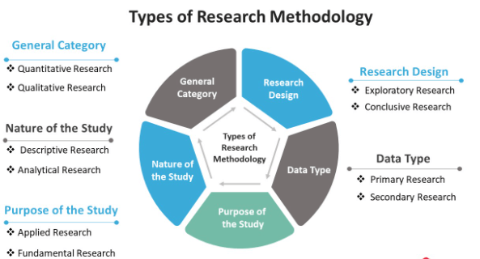

Slide 6
Quantitative Research
Quantitative data relies on quantifying a certain amount or quantity of a specific phenomenon.
It focuses on gathering and analyzing numerical data and can be used to find averages and patterns or to predict outcomes.
Quantitative Research falls within the two primary categories of research and relies on numbers.
It draws a conclusion using tables, facts, and graphs. Many scientific and field-based studies primarily use this form of research.

Slide 7
Quantitative Research
Pros:
It allows for larger sample sizes, enables thorough analysis of the findings, and helps draw broader conclusions about your target audience.
Since quantitative research uses surveys, experiments, and real-time data collection, there are minimal delays in gathering the data under study.
Therefore, the researcher analyzes the information under study quite rapidly compared to other research methodologies.
Due to anonymity, researchers frequently use quantitative data while examining sensitive topics.
Consequently, this setting lowers the possibility of producing inaccurate data.

Slide 8
Quantitative Research
Cons:
Since the researcher may be unable to conduct the research in the subjects’ natural environments, it may appear artificial and regulated.
Participants’ responses are claimed and may not reflect their actual real-life behavior.
Because survey responses are limited, you cannot go beyond that in delving more deeply into the behaviors, attitudes, and motives as you can with qualitative research.
There is a financial element to consider with quantitative research because it can be costly.

Slide 9
Qualitative Research
It refers to the non-numerical elements in the research.
Qualitative research comes to the rescue when the researcher cannot grasp the information or data regarding numbers.
Qualitative research helps to form a better summary of theories in the data.
This type of research is interested in discovering the motivating factors behind human behavior, i.e., why people act or think in a particular way.
Through this research, one can understand the variables driving people to behave in a certain way or which govern their inclinations toward one specific thing.

Slide 10
Qualitative Research
Pros:
Studies can be performed more quickly since qualitative research use a smaller sample size than other research methodologies.
Social scientists can efficiently gather data from participants using this framework, resulting in a generalization that will be helpful to the general public.
It enables a more in-depth exploration of attitudes and behavior because it’s more intimate and can go into specifics to better comprehend their thoughts and actions to formulate or examine a hypothesis.
It allows for flexibility because the interviewer can go into the subject and probe any questions they feel are relevant, and they can even alter the setting.

Slide 11
Qualitative Research
Cons:
The people you select to participate in the qualitative research may all have a particular opinion about the subject matter rather than a group with different views, implying bias in the sample selection.
It takes a long time to gather the data since it takes time to filter through the elements to decide what is useful and what is not.
Some participants may be concerned about privacy, particularly when discussing sensitive matters.

Slide 12
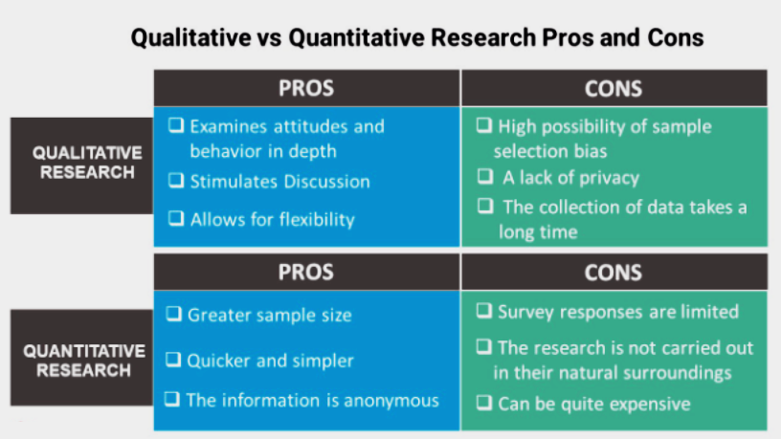

Slide 13
Descriptive Research
Descriptive research is a type of analysis that outlines the features of the population or issues under study.
This type of methodology focuses more on the “what” of the research problem than the “why.”
Since the researcher cannot influence the variables in this research design, they can only report the facts precisely as they occurred or are occurring.
The primary methods used in descriptive research include observations, surveys, and case studies.
One can use many variables in descriptive research to explain the facts.
Its advantages include
a) being effective at analyzing topics and issues that cannot rely on numbers,
b) being observable in an unaltered natural environment, and
c) taking less time than quantitative experiments.

Slide 14
Analytical Research
Analytical research uses proven facts to form the basis for the research.
Researchers frequently research to find supporting data that strengthens and authenticates their earlier findings.
Also, it helps to develop new concepts related to the research subject. Thus, analytical research combines minute details to produce more tenable hypotheses. The analytical study thus explains why a claim is valid.
There are various ways to conduct this research, including meta-analysis, literary or scientific trials, and learning about public opinion.
Moreover, the researcher carries out a critical evaluation of the material in this method.
Analytical methods also often make use of quantitative methods.

Slide 15
Applied Research
Action research that only studies one domain and usually generalizes the findings is called applied research.
The researcher regards the variables as constant, and the researcher forecasts, making the methods easy to find in applied research.
Applied research aims to solve a current issue facing society or a business/industrial organization.
Applied research is considered non-systematic inquiry; a business, government body, or individual typically conducts this research to address a particular issue.

Slide 16
Fundamental Research
Formulating a theory and generalizations are the primary concerns of fundamental research.
It seeks to discover facts with various applications, supplementing the ideas already known in a specific field or industry.
Several domains are connected, aiming to discover how one can change traditional things or develop something new.
One can find the summary in everyday language and apply logical findings in the research.
Some examples of fundamental research are research on generalizing human behavior or research on pure mathematics.

Slide 17
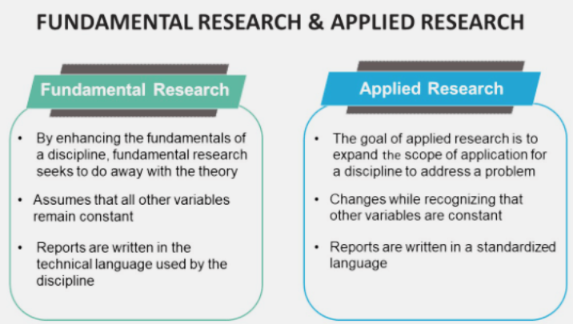

Slide 18
Exploratory Research
Theories and their explanation are the basis of Exploratory Research.
Its goal is only to investigate the study questions, not to provide definitive and conclusive solutions to current problems.
Exploratory research seeks to increase our understanding of the issue rather than offering conclusive evidence.
The structure is improper, and the methods offer a flexible and investigative approach. Therefore, one does not test the hypothesis, and the results do not help the outside world.
The findings are usually a related topic, which helps improve the research.
Exploratory research is usually qualitative, but a large-sample exploratory study can also be quantitative.
Due to its flexible and open-ended nature, it is often known as interpretive research or a grounded theory approach.

Slide 19
Conclusive Research
Conclusive research has a clear design in the methodology and intends to answer the research question.
A well-thought-out structure helps formulate and solve the hypotheses and gives the results. The results are generic here.
Furthermore, it is essential to establish this study’s research objectives and data requirements, as conclusive research findings typically have a specific purpose.
The results of exploratory studies can be validated and quantified using a conclusive research design.
A conclusive research design typically employs quantitative methods of data collection and analysis.
In addition, conclusive research frequently takes a deductive research approach.

Slide 20
Primary Research and Secondary Research
The researchers gather new data for primary research. The research classifies as primary when the researcher collects information on a certain topic for the first time. Surveys, interviews, and observation are common ways of gathering data.
Secondary research uses previously gathered data through primary research. Books, magazines, trade journals, and other media majorly serve as secondary data sources. Moreover, the researcher does not gather primary data in this case.

Slide 21
As all primary studies entail gathering and analyzing secondary data during the literature review stage, it is vital to remember that primary research also involves secondary research.
The key distinction between primary and secondary research is whether or not any researcher has undertaken the research previously.
Pros and cons
Primary data is more time-consuming and expensive, even though it is need-specific and high-quality.
Secondary research is inexpensive, and the data collection is simple, but there is a chance that the information will be obsolete or unsuitable for one’s needs. Therefore, one must first assess these two options’ requirements, sources, expenses, etc., before selecting one.

Slide 22
Surveys
Surveys play a prominent role in the research method. It helps collect a vast amount of real-time data and helps the research process.
It is done cheaply and is usually faster than any other method. A researcher can conduct surveys in both quantitative and qualitative methods.
The researcher usually prefers quantitative surveys over qualitative ones as they provide numerical outputs and accurate data.
Surveys are mainly used in the business to know the demand for a product in the market.
Questionnaires and interviews are two of the most common types of surveys.
While interviews are conducted in person to reflect on feelings and experiences and explore issues with a greater emphasis, researchers use questionnaires to acquire information quickly.

Slide 23
Case Studies
Case study method, which entails thorough observation of a social unit and focuses on the in-depth study.
The case study emphasizes the detailed examination of a smaller set of circumstances and their interactions.
Finding the elements that collectively account for the behavior patterns of the provided unit is the goal of the case study method.
In this, the researcher considers different cases, and the proper one for the research is selected.
Case studies help to develop an idea of the research and help in the foundation of the research.
One considers various facts and theories from the case studies that help to form proper reviews about the research topic.
Researchers can make the topic general or specific according to the literature reviews from the studies.The researcher can make an appropriate understanding of the research from the case study.

Slide 24
Data
Data is a set of values of subjects with respect to qualitative or quantitative variables.
It is raw, unorganized facts that need to be processed. Data can be something simple and seemingly random and useless until it is organized.
When data is processed, organized, structured or presented in a given context so as to make it useful, it is called information.
Information is necessary for research activities and the choice of type of data depends on the facilities available, the extent of accuracy required in analysis, the expertise of the investigator, the time span of the study and the amount of money and other resources required for data collection.

Slide 25
Research Data Formats
Text: This format includes any type of written data, such as interview transcripts, survey responses, or open-ended questionnaire answers.
Numeric: This format includes any data that can be expressed as numerical values, such as measurements or counts.
Audio: This format includes any recorded data in an audio form, such as interviews or focus group discussions.
Video: This format includes any recorded data in a video form, such as observations of behavior or experimental procedures.
Images: This format includes any visual data, such as photographs, drawings, or scans of documents.
Mixed media: This format includes any combination of the above formats, such as a survey response that includes both text and numeric data, or an observation study that includes both video and audio recordings.

Slide 26
Research Data Formats
Sensor Data: This format includes data collected from various sensors or devices, such as GPS, accelerometers, or heart rate monitors.
Social Media Data: This format includes data collected from social media platforms, such as tweets, posts, or comments.
Geographic Information System (GIS) Data: This format includes data with a spatial component, such as maps or satellite imagery.
Machine-Readable Data: This format includes data that can be read and processed by machines, such as data in XML or JSON format.
Metadata: This format includes data that describes other data, such as information about the source, format, or content of a dataset.

Slide 27
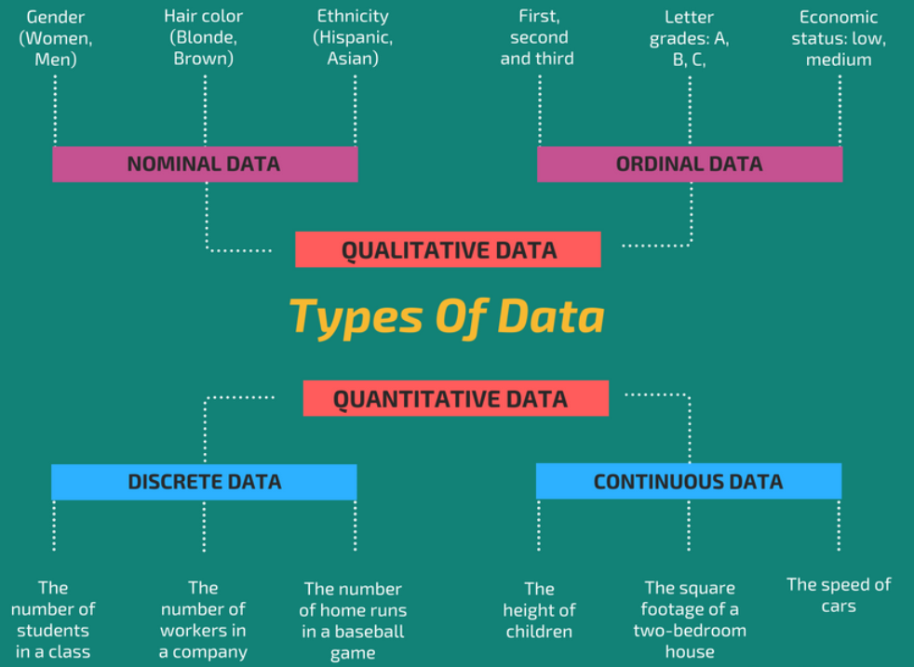

Slide 28
Quantitative and qualitative data
Qualitative data are typically raw data from interviews, focus groups, observations, documents, or multimedia content.
In most cases, qualitative data appear as text, because data obtained from interviews and observations may be documented as written transcriptions or field notes.
Quantitative data are characterized by a high degree of standardization. This sort of data are obtained, for instance, through close-ended questions and quantitative content analyses.
Obtained raw data, such as media content, must be first structured in order to be applicable to statistical analysis.

Slide 29
Categorized and quantified data
Nominal and ordinal data are referred to as categorical data or qualitative data.
Interval and ratio data are numerous data and are hence referred to as quantitative data.
However, a quantitative survey may include all of these types of data, since nominal and ordinal data can also be expressed through numerical codes.

Slide 30
Cross-sectional, panel, and process-oriented data
Data can either describe characteristics of the observed cases for one point in time or contain information on changes over time, are called cross- sectional data.
Panel data are obtained through a study that is conducted at several points in time. Panel data are obtained by using the same sample for each time period.
Process-oriented data are obtained through experimental measurement techniques such as thought listing, eye-tracking, physiological reactions, or real-time-response measurement.
Process-oriented experiments obtain information on changes in the dependent variable for one individual throughout a given time period.
process-oriented data usually include only a limited number of cases and variables

Slide 31
Primary and secondary data

Slide 32
Primary Data
are those which are collected afresh and for the first time,
original in character,
collected specially for a research purpose ,
may be shared publicly to be used for other research,
often reliable, authentic, and objective

Slide 33
Advantages of Primary Data
It is specific to the needs of the researcher at the moment of data collection.
Researcher is able to control the kind of data that is being collected.
The data is not subjected to personal bias.
The researcher has ownership of this type of data. He or she may choose to make it available publicly, patent it, or even sell it.
It is collected in real-time and not collected from old sources.
Limitations of Primary Data
It is expensive compared to secondary data.
It is time-consuming.
It may not be feasible to collect primary data in some cases due to its complexity and required commitment

Slide 34
COLLECTION OF PRIMARY DATA
It is collected during the course of doing experiments in an experimental research and performing surveys during descriptive research .
It can be obtained either through observation or through direct communication with respondents in one form or another.
Thus, the several methods of collecting primary data are:
observation method
interview method
through questionnaires.

Slide 35
Observation Method of data collection
The investigator just observes and records the behavior as it occurs of an event which he is interested in.
Sometimes mechanical devices can also be used to record the desired data.
This type of method of data collection is best suited for researches which require non-self report descriptive data.
This method is most appropriate when respondent’s behavior is to be understood without asking them so as to record their true behavior in the given setting.
The main advantages of this method are:
Elimination of subjective bias, if accuracy in observation is maintained.
The information obtained relates to current happenings.
It is not affected by either the past behavior or future intentions.
This method is independent of respondents’ willingness to respond
Limitations
An expensive method.
Information provided by this method is very limited.
Sometimes unforeseen factors may interfere with the observational task.
Some people are rarely accessible to direct observation

Slide 36
Interview Method
Interview Method Interviews can be conducted either face to face (Personal Interview) or over telephone (Telephonic Interviews).
Personal interviews
Requires a person known as the interviewer asking questions generally in a face-to-face contact to the other person or persons (interviewee).
Usually the interviewer initiates the interview and asks questions and collects the information from the respondent(interviewee).
This method is particularly suitable for intensive investigations.
Personal interviews are expensive and time consuming if there is a big sample.
Interviewers’ biases also come in the way

Slide 37
Telephonic Interview
Telephonic Interview helps establish contact with the respondent spread over distinctly separated geographic locations.
One can obtain responses quickly .
This method is effective only when the interviewer has specific questions to ask.
Interviewer in this case cannot observe the nonverbal responses of the respondent.
The respondent if not interested can terminate the interview without informing or explanation
It is more flexible in comparison to mailing method.
Recall is easy; callbacks are simple and economical.
The non-response is generally very low.
Replies can be recorded without causing embarrassment to respondents.
No field staff is required.

Slide 38
Limitations of Telephonic Interviews
Surveys are restricted to respondents who have telephone facilities.
Extensive geographical coverage may get restricted by cost considerations.
Suitable for intensive surveys where comprehensive answers are required to various questions.
Possibility of the bias of the interviewer is relatively more.
Questions have to be short and to the point;
Probes are difficult to handle.

Slide 39
Questionnaire Method
Questionnaire is as an instrument for research, which consists of a list of questions, along with the choice of answers, printed or typed in a sequence on a form used for acquiring specific information from the respondents.
The questionnaire is distributed or mailed to respondents who are expected to reply by writing down their opinion or marking the correct option.
The respondents have to answer the questions on their own.
The method of collecting data by mailing the questionnaires to respondents is largely used in various economic and business surveys.

Slide 40
Advantages
There is low cost even when the universe is large and is spread geographically.
It is free from the bias of the interviewer.
Answers are in respondents’ own words.
Respondents have adequate time to give well thought out answers.
Large samples can be made use of .
The results can be made more dependable and reliable
Disadvantages of Questionnaires
Low rate of return of the duly filled in questionnaire,
no-response cannot be anticipated,
It can be used only when respondents are educated,
The control over questionnaire is lost once it is sent,
There is inbuilt inflexibility as the questions or even their order cannot be changed,
This method is likely to be the slowest of all.

Slide 41
Secondary Data
are those which have already been collected by someone else and
which have already been passed through some statistical process.
are usually once primary data but become secondary when used by someone else.
are usually easily accessible to researchers and individuals because they are mostly shared publicly.
the data are usually general and not tailored specifically to meet the researcher's needs .
Some common sources of secondary data include trade publications, government statistics, journals, etc.

Slide 42
Advantages of Secondary Data
It is easily accessible compared to primary data.
It is available on different platforms that can be accessed by the researcher.
It is very affordable as it requires little or no cost to acquire them.
The time spent on collecting secondary data is far less compared to that of primary data.
It helps to generate new insights into existing primary data.
Limitations of Secondary Data
Secondary data may not be authentic and reliable. A researcher may need to further verify the data collected from the available sources.
Researchers may have to deal with irrelevant data before finally finding the required data.
Some of the data is exaggerated due to the personal bias of the data source.
Secondary data sources are sometimes outdated with no new data to replace the old ones. .

Slide 43
Secondary Data sources

Slide 44
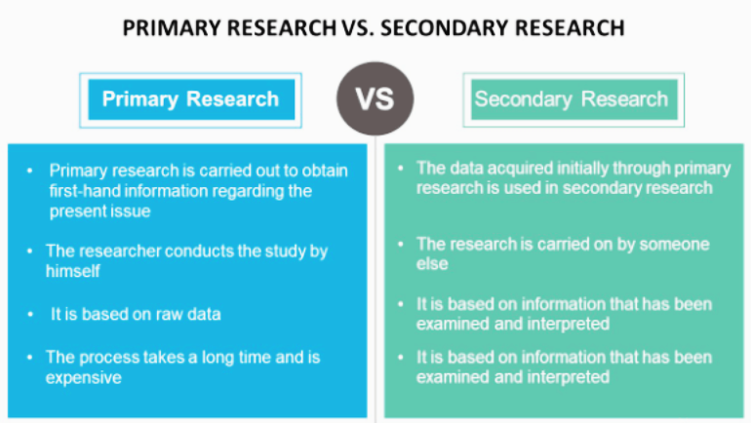

Slide 45
Data Classification
Data classification is the process of organizing data into categories that make it easy to retrieve, sort and store for future use.
A well-planned data classification system makes essential data easy to find and retrieve.
This can be of particular importance for risk management, legal discovery and regulatory compliance.
Written procedures and guidelines for data classification policies should define what categories and criteria the organization will use to classify data.
Once a data classification scheme is created, security standards should be identified that specify appropriate handling practices for each category.

Slide 46
Purpose of data classification
Systematic classification of data helps organizations manipulate, track and analyze individual pieces of data.
Data professionals often have a specific goal when categorizing data.
The goal affects the approach they take and classification levels they use.

Slide 47
Some common business goals for these projects include the following:
Confidentiality. A classification system safeguards highly sensitive data, such as customers' personally identifiable information (PII), including credit card numbers, Social Security numbers and other vulnerable data types.
Data integrity. A system that focuses on data integrity will require more storage, user permissions and proper channels of access.
Data availability. Addressing and ensuring information security and integrity makes it easier to know what data can be shared with specific users.

Slide 48
Importance of data classification
Data classification is an important part of data lifecycle management that specifies which standard category or grouping a data object belongs in.
Data classification is used to categorize structured data, but it is especially important for getting the most out of unstructured data. Data categorization also helps identify duplicate copies of data.
Eliminating redundant data contributes to efficient use of storage and maximizes data security measures.

Slide 49
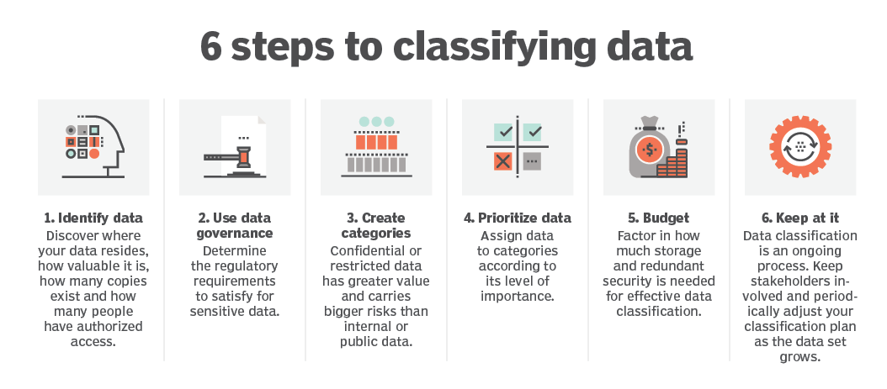

Slide 50
Common data classification steps
Gather information. At the start of a data categorization project, organizations must identify and inspect the data that needs to be classified or reclassified. It's important to know where it resides, how valuable it is, how many copies exist and who has access to it.
Develop a framework. Data scientists and other stakeholders collaborate to develop a framework within which to organize the data. They assign metadata or other tags to the information.
Apply standards. Companies must ensure their data classification strategy conforms to their internal data protection and handling practices and reflects industry standards and customer expectations.
Process data. This step requires taking stock of the database and identifying and sorting data according to the established framework.

Slide 51
Types of data classification
Public information. Data in this category is typically maintained by state institutions and subject to disclosure of public data as part of certain laws.
Confidential information. This data may have legal restrictions about the way it is handled, or there may be other consequences around the way confidential data is handled.
Sensitive information. This data is any information stored or handled by state or other institutions that has authorization requirements and other rules around its use.
Personal information. Generally, personal information or PII is protected by law, and must be handled following certain protocols. Sometimes there are gaps between the moral requirements and contemporary legislative protections for their use.

Slide 52
Tools used for data classification
Various tools are used in data classification, including databases, business intelligence (BI) software and standard data management systems.
IBM’s Watson Knowledge Catalog
Microsoft’s Purview Data Catalog
SAP
Oracle
Informatica
Qlik
Tableau
Google’s Cloud Data Catalog
Amazon Web Services
Ataccama
Collibra
DataHub and Apache Atlas

Slide 53
How to Classify Research Data
Appropriately protecting research data is a fundamental obligation warranted by the research community's underlying commitments to:
the providers and sources of the data,
uphold the efficacy of the campus' research mission, and
to prevent financial or reputational damages to the University.
To protect research data appropriately and effectively, researchers must understand and carry out their responsibilities related to data security.
The first step towards that goal is to identify the appropriate data classification, which defines the necessary security control requirements for protecting research data.

Slide 54
Why should research data be classified?
Researchers must securely protect research data when:
The data elements pose a risk of exposing the identity of the research participants.
The risk of exposure includes personal medical or financial information, social security or driver's license numbers, or other highly sensitive information that could require notification to the affected research participants in the event of a breach.
A data usage agreement (DUA) from the data provider explicitly stipulates the related security control requirements.
Researchers also must meet campus security policies:
To provide baseline protection of the research data that corresponds to the protection level classification, regardless of an existing DUA.
To act as responsible members of the campus computing community by protecting endpoint and server devices from compromise that could affect other members of campus.

Slide 55
Steps for classifying research data

Slide 56
Step 1 | Start by identifying the purpose and nature of the research and the data to be classified. | Does the research involve human subjects? Is the data public (no sharing restriction) or private (only those with a need-to-know can access)
Step 2 | Identify the specific data elements. | For example: Health-related information Personally Identifiable Information (PII) Data collected about human research subjects
Step 3 | Identify any laws, regulations, or data usage agreements that govern the data. | Is there a DUA (Data Usage Agreement) between the research unit and the data-provider? (e.g., social security number, driver's license number) Does the data include health information protected by HIPAA?

Slide 57
Step 4 | Estimate the number of sensitive records stored. | Use this number to help determine the potential impact of a breach For data elements, does the number of records exceed the minimum limit for "notice-triggering" requirements?
Step 5 | Understand what notification requirements may exist in the event of a breach and the potential impact of those requirements. | Does the DUA specify requirements for an incident response plan? Who will need to be contacted when a security incident is reported? Estimate the cost of notification in the event of a breach Include potential DUA penalties or fees, and possible litigation costs
Step 6 | Estimate the impact to the research project if the data is lost. | Will the research project be able to continue unimpeded if the data is lost? Is there a backup plan? How will the project be affected if lost work and delays impact the research? Will the validity of the research outcome be in question because of a security event? How will the reputation of the research unit (and the University) be affected by a breach, especially in terms of future projects and funding?

Slide 58
Find data examples
Data class | Impact
Protection Level: UC P4 | High (Extremely sensitive individually identifiable information)
Protection Level: UC P3 | Moderate (Moderately sensitive individually identifiable information)
Protection Level: UC P2 | Low (Non-public, non-sensitive information and de-identified information)
Protection Level: UC P1 | Minimal (Public information)

Slide 59
Statistical design of experiments
Design of experiments (DOE) is defined as a branch of applied statistics that deals with planning, conducting, analyzing, and interpreting controlled tests to evaluate the factors that control the value of a parameter or group of parameters.
DOE is a powerful data collection and analysis tool that can be used in a variety of experimental situations.

Slide 60
In Statistics, the experimental design or the design of experiment (DOE) is defined as the design of an information-gathering experiment in which a variation is present or not, and it should be performed under the full control of the researcher. This term is generally used for controlled experiments.
These experiments minimise the effects of the variable to increase the reliability of the results.
In this design, the process of an experimental unit may include a group of people, plants, animals, etc.

Slide 61
It allows for multiple input factors to be manipulated, determining their effect on a desired output (response).
By manipulating multiple inputs at the same time, DOE can identify important interactions that may be missed when experimenting with one factor at a time.
All possible combinations can be investigated (full factorial) or only a portion of the possible combinations (fractional factorial).

Slide 62
Types of Experimental Designs
Pre-experimental Research Design
True-experimental Research Design
Quasi-Experimental Research Design

Slide 63
Pre-experimental Research Design
The simplest form of experimental research design in Statistics.
In this method, a group or various groups are kept under observation, after some factors are recognised for the cause and effect.
This method is usually conducted in order to understand whether further investigations are needed for the targeted group.
That is why this process is considered to be cost-effective.
This method is classified into three types,
Static Group Comparison
One-group Pretest-posttest Experimental Research Design
One-shot Case Study Experimental Research Design

Slide 64
True-experimental Research Design
This is the most accurate form of experimental research design as it relies on the statistical hypothesis to prove or disprove the hypothesis.
This is the most commonly used method implemented in Physical Science.
True experimental research design is the only method that establishes the cause and effect relationship within the groups.
The factors which need to be satisfied in this method are:
Random variable
Variable can be manipulated by the researcher
Control Groups (A group of participants are familiar with the experimental group, but the experimental rules do not apply to them)
Experimental Group (Research participants where experimental rules are applied)

Slide 65
Quasi-Experimental Design
A quasi-experimental design is similar to a true experimental design, but there is a difference between the two.
In a true experiment design, the participants of the group are randomly assigned. So, every unit has an equal chance of getting into the experimental group.
In a quasi-experimental design, the participants of the groups are not randomly assigned. So, the researcher cannot make a cause or effect conclusion. Thus, it is not possible to assign the participants to the group.

Slide 66
Apart from these types of experimental design research in statistics, there are other two methods used in the research process such as randomized block design and completely randomized design.

Slide 67
Key concepts in creating a designed experiment include blocking, randomization, and replication.
Blocking: When randomizing a factor is impossible or too costly, blocking lets you restrict randomization by carrying out all of the trials with one setting of the factor and then all the trials with the other setting.
Randomization: Refers to the order in which the trials of an experiment are performed. A randomized sequence helps eliminate effects of unknown or uncontrolled variables.
Replication: Repetition of a complete experimental treatment, including the setup.

Slide 68
When to Use DOE
Use DOE when more than one input factor is suspected of influencing an output. For example, it may be desirable to understand the effect of temperature and pressure on the strength of a glue bond.
DOE can also be used to confirm suspected input/output relationships and to develop a predictive equation suitable for performing what-if analysis.

Slide 69
Design of Experiments Template and Example
Begin your DOE with three steps:
Acquire a full understanding of the inputs and outputs being investigated. A process flowchart or process map can be helpful. Consult with subject matter experts as necessary.
Determine the appropriate measure for the output. A variable measure is preferable. Attribute measures (pass/fail) should be avoided. Ensure the measurement system is stable and repeatable.
Create a design matrix for the factors being investigated. The design matrix will show all possible combinations of high and low levels for each input factor. These high and low levels can be coded as +1 and -1.

Slide 70
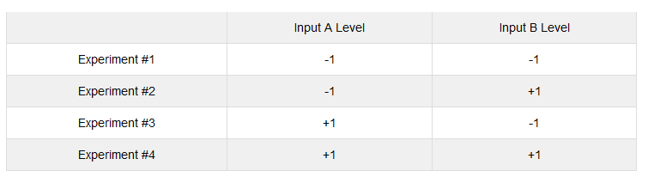
The required number of experimental runs can be calculated using the formula 2^{n}, where n is the number of factors.

Slide 71
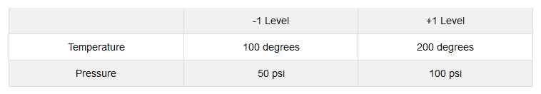
For each input, determine the extreme (but realistic) high and low levels you wish to investigate. In some cases the extreme levels may be beyond what is currently in use. The extreme levels selected should be realistic, not absurd.

Slide 72
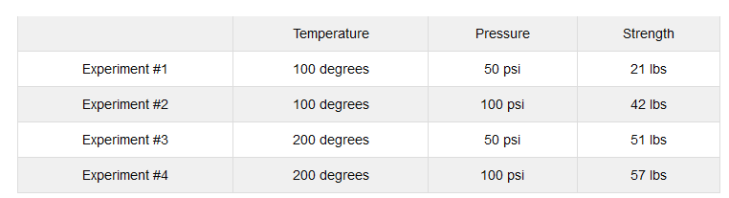
Enter the factors and levels for the experiment into the design matrix. Perform each experiment and record the results.

Slide 73
Calculate the effect of a factor by averaging the data collected at the low level and subtracting it from the average of the data collected at the high level.
Effect of temperature on strength:
(51 + 57)/2 - (21 + 42)/2 = 22.5 lbs
Effect of pressure on strength:
(42 + 57)/2 - (21 + 51)/2 = 13.5 lbs

Slide 74
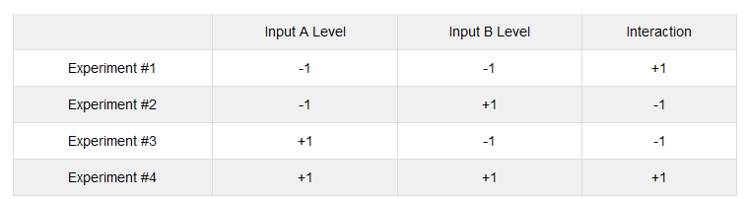
The interaction between two factors can be calculated in the same fashion. First, the design matrix must be amended to show the high and low levels of the interaction. The levels are calculated by multiplying the coded levels for the input factors acting in the interaction.
Calculate the effect of the interaction as before.
Effect of the interaction on strength: (21 + 57)/2 - (42 + 51)/2 = -7.5 lbs

Slide 75
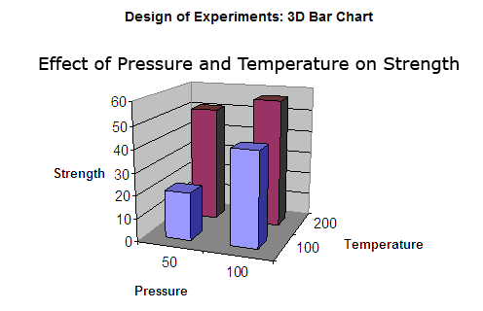

Slide 76
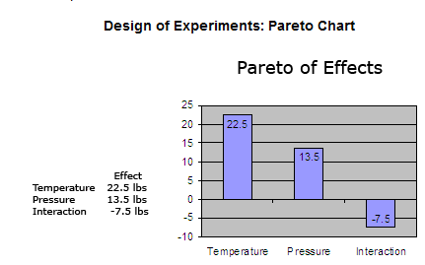

Slide 77
The negative effect of the interaction is most easily seen when the pressure is set to 50 psi and Temperature is set to 100 degrees.
Keeping the temperature at 200 degrees will avoid the negative effect of the interaction and help ensure a strong glue bond.

